Slide 1


Python for Data Wrangling
by Sokchea AN

Slide 2

Course objective
Using Python and Pandas and Numpy to
Get data
Review data
Clean, standardise, transform and augment data
Analyse/visualise data
Communicate data

Slide 3
Chapter 1 - Intro
Setup Environment
Python in a nutshell
Setup Python
Setup and overview of Pycharm
The Zen of Python

Slide 4
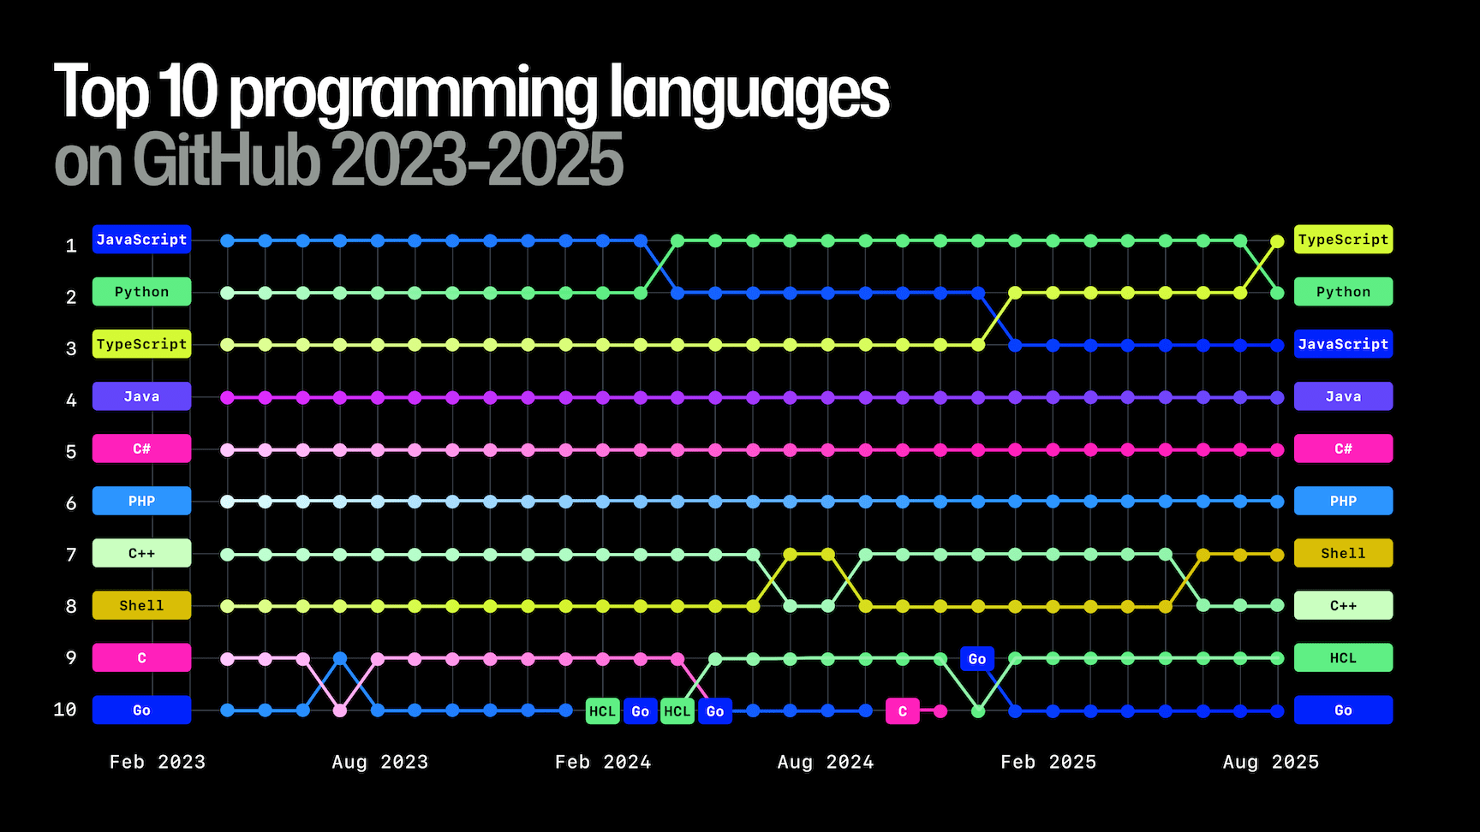
Python in a nutshell
It is a high-level, general-purpose programming language: easy to learn and use
Second most popular programming language
Programming language of choice for data analysis, data science and AI

Slide 5
Setup Python
Setup Environment
Download python: https://www.python.org/ftp/python/3.12.10/python-3.12.10-amd64.exe
Click install and follow the installation processes

Slide 6
Setup IDE
Setup Environment
Dowload Pycharm: https://www.jetbrains.com/pycharm/download
Follow installation processes

Slide 7
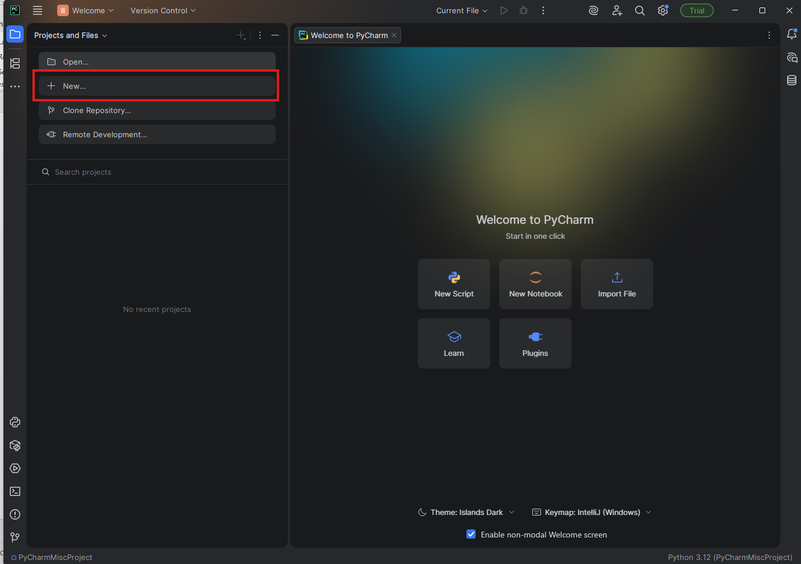
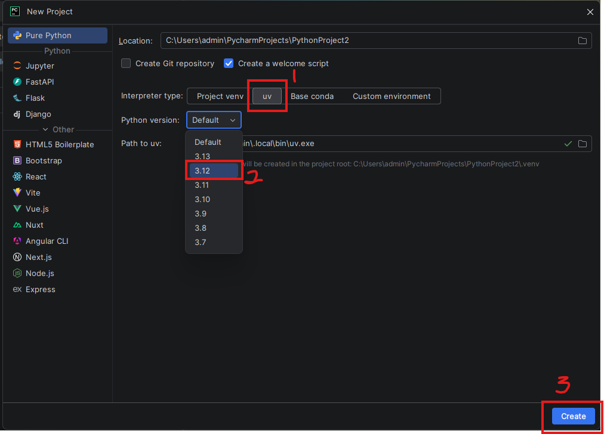
New Project
Open Pycharm
Click “New”
Interpreter type, select “uv”
Python version, select 3.12
Click “Create”

Slide 8
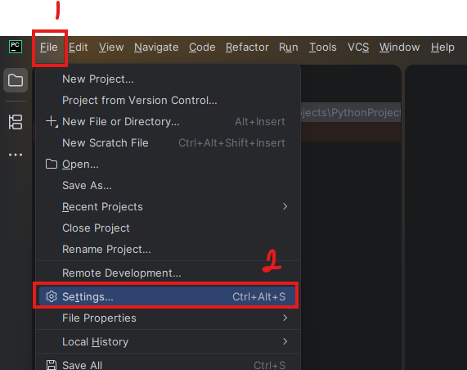
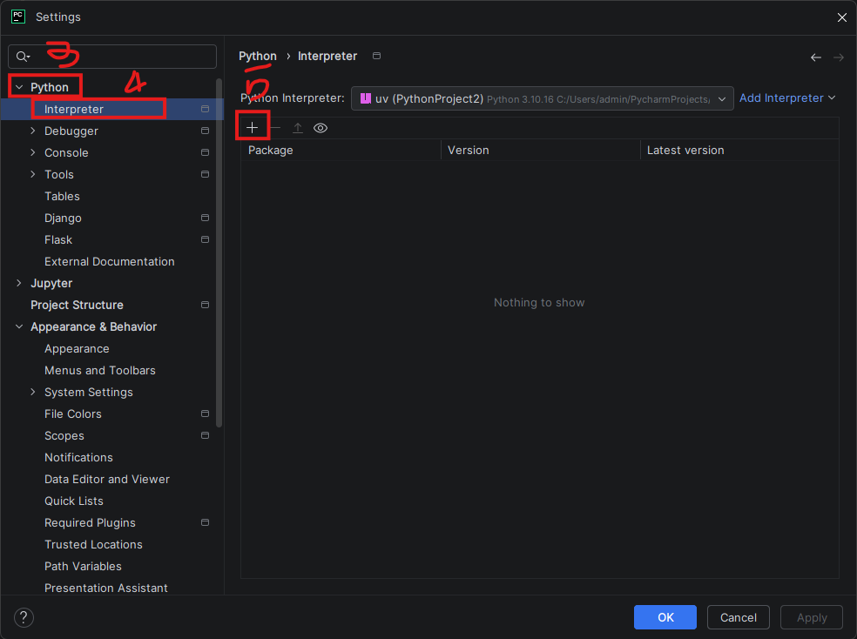
Install libraries/packages
File -> Settings
Python -> Interpreter -> Add package
Below are common packages we will use in the course. Let’s add:
Pandas
Numpy
Openlyxl
Sqlalchemy
Asyncpg
Psycopg2-binary
Matplotlib
Seaborn
jupyterlab

Slide 9
Get to know Pycharm a bit more

Slide 10
Pycharm IDE
PyCharm is a dedicated Python Integrated Development Environment (IDE) providing a wide range of essential tools for Python developers, tightly integrated to create a convenient environment for productive Python, web, and data science development.
Recommended computer specs:
8GB of RAM
Multi-core CPU
5GB of SSD storage space

Slide 11
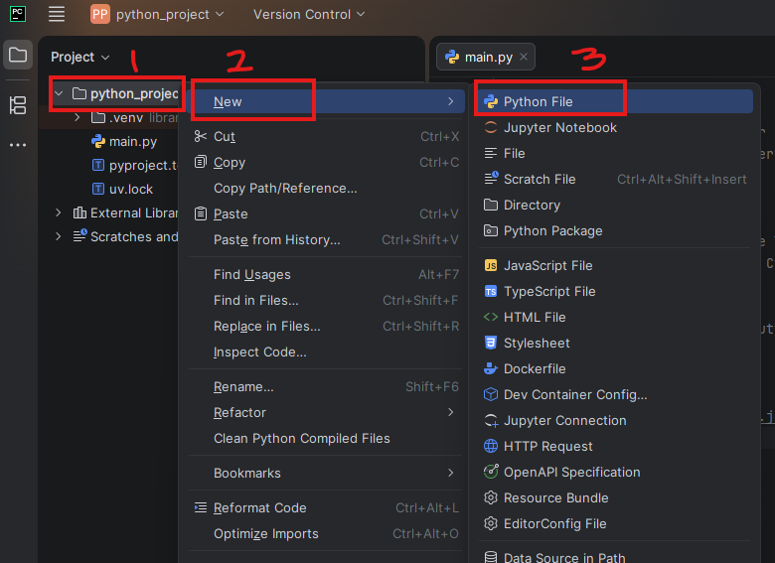
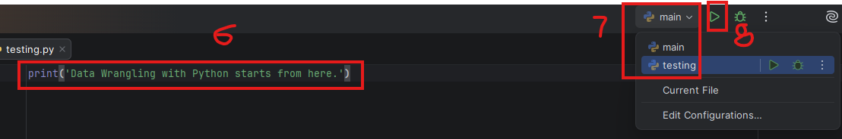
Python script in Pycharm
At the left pane, right click at where you want to create the script
Click “New”
Click “Python Script”
Type script name
Select “Python file” then press enter
Write some script
Select script file to run
Click run

Slide 12
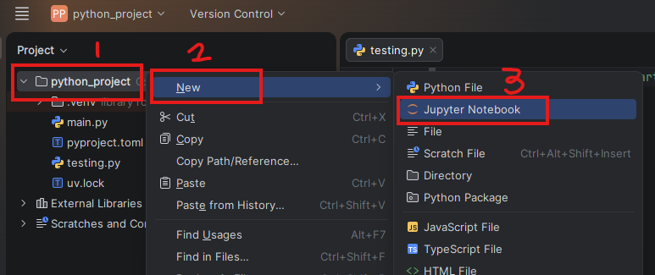


Python notebook in Pycharm
At the left pane, right click at where you want to create the script
Click “New”
Click “Python Script”
Type script name
Select “Python file” then press enter
Write some script
Select script file to run
Click run

Slide 13
Which Python tools to use?
Notebook: an interactive web-based development environment
Interactive Python script development
Data analysis and data science
Data visualisation
Python script: Writing script for a deployable Python application
Web application
Turning notebook script into a deployable application

Slide 14
The zen of Python

Slide 15
>>> import this
The Zen of Python, by Tim Peters
Beautiful is better than ugly.
Explicit is better than implicit.
Simple is better than complex.
Complex is better than complicated.
Flat is better than nested.
Sparse is better than dense.
Readability counts.
Special cases aren't special enough to break the rules.
Although practicality beats purity.
Errors should never pass silently.
Unless explicitly silenced.
In the face of ambiguity, refuse the temptation to guess.
There should be one-- and preferably only one --obvious way to do it.
Although that way may not be obvious at first unless you're Dutch.
Now is better than never.
Although never is often better than *right* now.
If the implementation is hard to explain, it's a bad idea.
If the implementation is easy to explain, it may be a good idea.
Namespaces are one honking great idea -- let's do more of those!

Slide 16
Any question?

Slide 17








Contact
(855) 12 955 658
info@kmaker.io
Address: Street 586, Sangkat Teuk L’ak ti 1,Khan Toul Kork, Phnom Penh, Cambodia

